Slide 1
Capstone Project- 4
Zomato Restaurant Clustering and Sentiment Analysis
by-
Souvik Bhattacharyya

Slide 2
Contents
Abstract
Data Summary
Basic Exploration
Pre Processing Data
Exploratory Data Analysis
Top Rating Restaurants in the City
The Most Popular Cuisines in Hyderabad
Costliest Restaurants
Cheapest Restaurants
Clustering
Elbow Method
Silhouette Score
Restaurant Clustering
Sentiment Analysis
Conclusion

Slide 3
Abstract
The Project focuses on analyzing the Zomato restaurant data. In today’s digitized modern world, the popularity of food apps is increasing due to their functionality to view, book, and order food with a few clicks on the phone for their favorite restaurant or cafes, by surveying the user ratings and reviews of the previously visited customers. Zomato is a site where someone can give a review of a restaurant, how the restaurant is, and someone's opinion about the restaurant.

Slide 4
Data Summary
Dataset contains two data Zomato Restaurant names and Metadata and Zomato Restaurant reviews
Data Description –1
Zomato Restaurant names and Metadata Attribute Information:
Name: Name of Restaurants
Links: URL Links of Restaurants
Cost: Per person estimated Cost of dining
Collection: Tagging of Restaurants w.r.t. Zomato categories
Cuisines: Cuisines served by Restaurants
Timings: Restaurant Timings
Data Description –2
Zomato Restaurant reviews
Restaurant: Name of the Restaurant
Reviewer: Name of the Reviewer
Review: Review Text
Rating: Rating Provided by Reviewer
MetaData: Reviewer Metadata -No. of Reviews and followers
Time: Date and Time of Review
Pictures: No. of pictures posted with a review

Slide 5
Basic Exploration
Data of 105 restaurants.
Data of 9000 reviews.
0.36 percent null values were present.
50 percent of the collected data is missing.
The average price of a Restaurant ranges from 150 to 2800..

Slide 6
Pre Processing Data
While processing the data we tend to :
In the metadata dataset, the collection feature contains more than 50% of null values, so we are dropping the collections feature.
Removing some columns which are not necessary for our analysis.

Slide 7
Exploratory Data Analysis

Slide 8
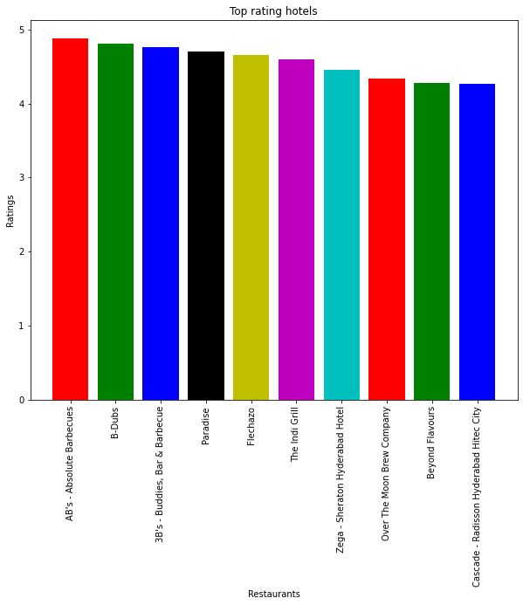
Top Rating Restaurants in the City
The top 10 rating restaurants are visualized.
AB’s has the highest rating among the restaurants and other top-rating restaurants are B-Dubs, 3B’s, Paradise, Flechazo, and so on.

Slide 9
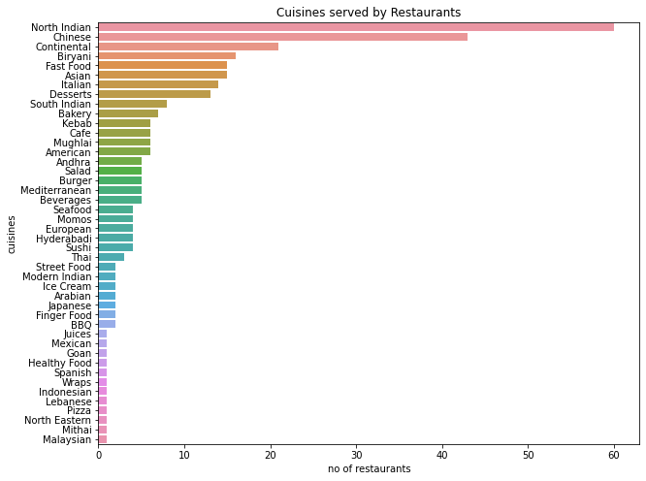
The Most Popular Cuisines in Hyderabad
The most popular cuisine is North Indian followed by Chinese, continental, Biriyani, Fast food, Asian, Italian, Deserts, and so on.
The least popular cuisines are Pizza, North Eastern, Mithai, Malaysian, etc.

Slide 10
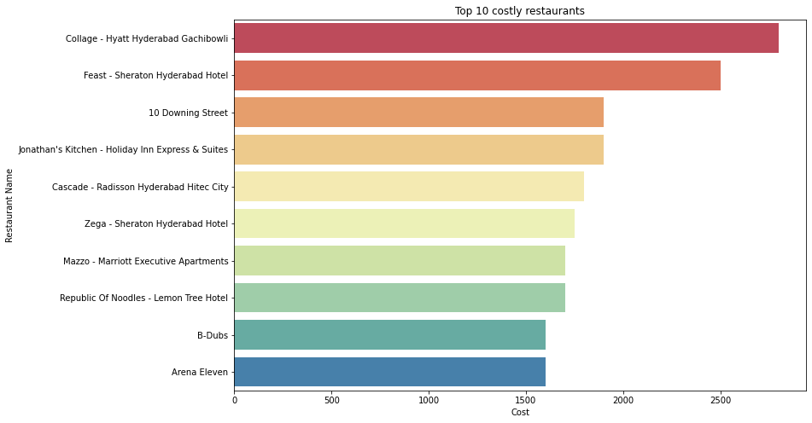
Costliest Restaurants
Collage is the costliest restaurant whose Per person estimated Cost of dining is 2800 followed by feast whose estimate costing is 2500 then followed by 10 downing street, Jonathan’s kitchen, cascade, Zega etc.

Slide 11
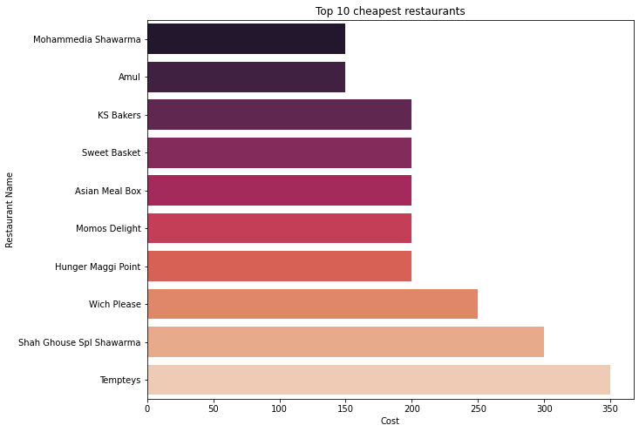
Cheapest Restaurants
Mohammedia Shawarma and Amul is the cheapest restaurant with a dining cost of Rs 150 each followed by KS Bakers, Sweet Basket, Asian Meal Box, Momos Delight, Hunger Maggi Point dining cost Rs 200 for each restaurant.

Slide 12
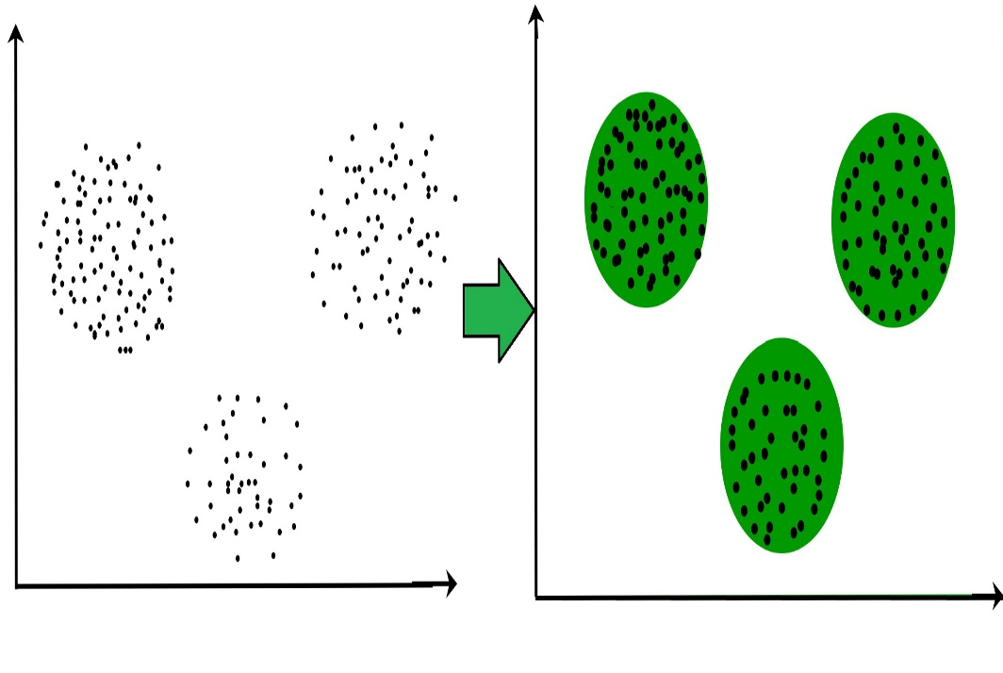
CLUSTERING
Clustering is the task of dividing the population or data points into a number of groups such that data points in the same groups are more similar to other data points in the same group and dissimilar to the data points in other groups. It is basically a collection of objects on the basis of similarity and dissimilarity between them.

Slide 13
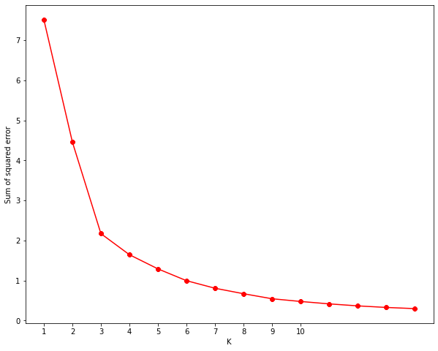
ELBOW METHOD
The elbow method is a heuristic used in determining the number of clusters in a data set. The method consists of plotting the explained variation as a function of the number of clusters and picking the elbow of the curve as the number of clusters to use.
We can visualize from the elbow technique that 6 is the optimal cluster number ranging from 1 to 15.

Slide 14
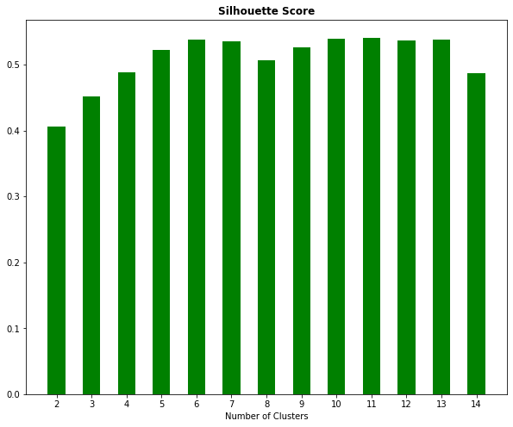
SILHOUETTE SCORE
Parameter: {'n_clusters': 2} Score 0.40623160975233424 Parameter: {'n_clusters': 3} Score 0.45099097721261666 Parameter: {'n_clusters': 4} Score 0.48798223363760623 Parameter: {'n_clusters': 5} Score 0.5220060131865882 Parameter: {'n_clusters': 6} Score 0.5374837049173882 Parameter: {'n_clusters': 7} Score 0.5350758343699564 Parameter: {'n_clusters': 8} Score 0.5061123368975379 Parameter: {'n_clusters': 9} Score 0.5254206014213741 Parameter: {'n_clusters': 10} Score 0.5385741276396574 Parameter: {'n_clusters': 11} Score 0.5408715582633872 Parameter: {'n_clusters': 12} Score 0.5359250365286276 Parameter: {'n_clusters': 13} Score 0.537618545043967 Parameter: {'n_clusters': 14} Score 0.4864873452933332
We have used Silhouette Score to find the best cluster for the data set.
We found that n_cluster:11 has the best score so we will implement 11 clustering in the dataset.

Slide 15
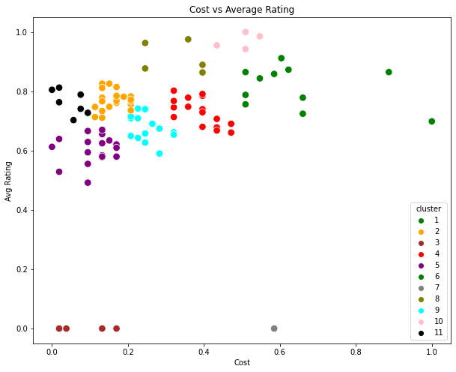
Restaurant Clustering
We have visualized the clusters in a scatter plot with different colors for cost vs average ratings.

Slide 16
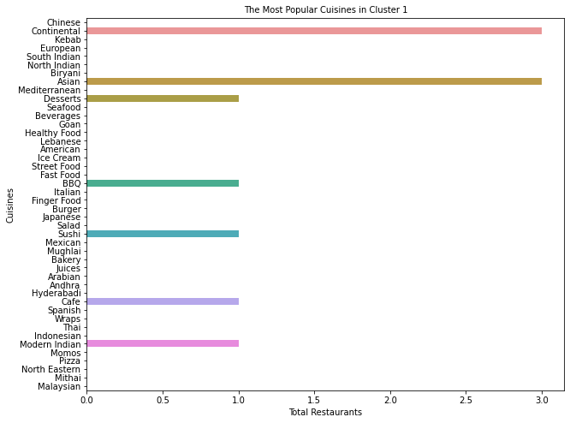
Cluster 1:
Average Rating: 3.84
Average Cost: 1125
Total hotels : 6

Slide 17
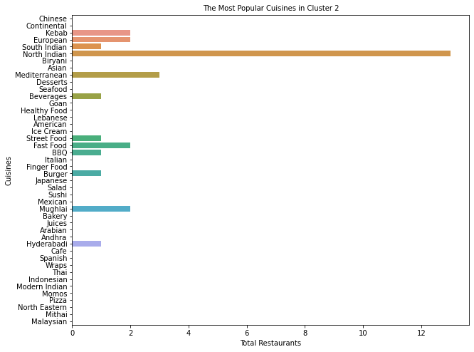
Cluster 2:
Average Rating: 3.73
Average Cost: 900 INR
Total hotels : 13

Slide 18
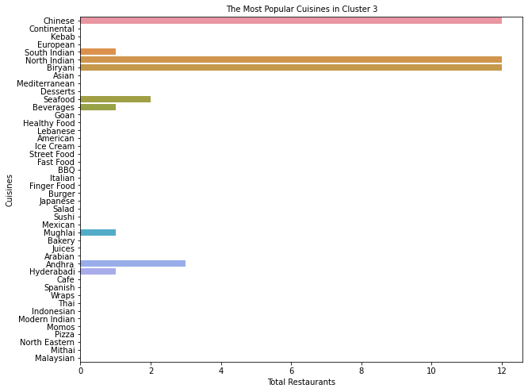
Cluster 3:
Average Rating: 3.13
Average Cost: 666 INR
Total hotels: 12

Slide 19
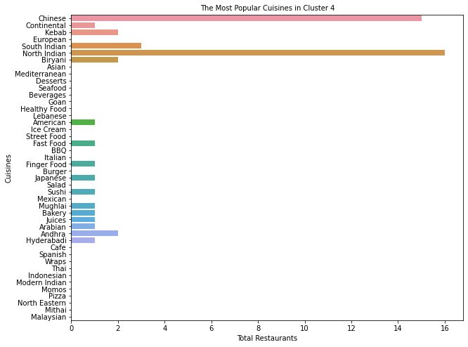
Cluster 4:
Average Rating: 3.31
Average Cost: 734 INR
Total hotels : 16

Slide 20
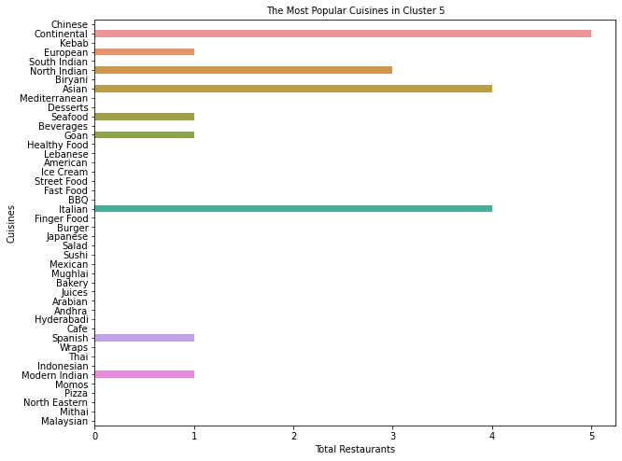
Custer 5:
Average Rating: 4.02
Average Cost: 1640 INR
Total hotels: 5

Slide 21
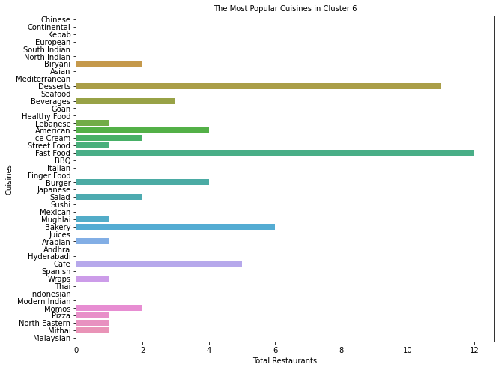
Cluster 6:
Average Rating: 3.17
Average Cost: 489 INR
Total hotels : 28

Slide 22
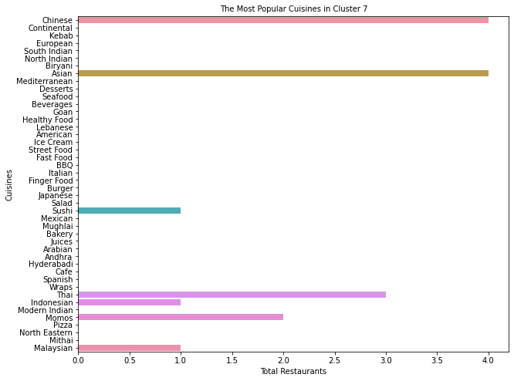
Cluster 7:
Average Rating: 2.52
Average Cost: 1112 INR
Total hotels : 4

Slide 23
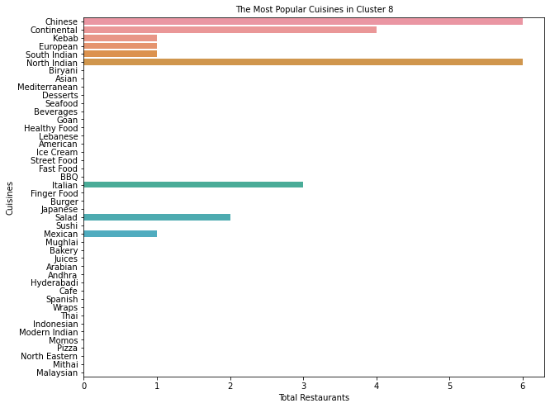
Cluster 8:
Average Rating: 3.73
Average Cost: 1208 INR
Total hotels : 6

Slide 24
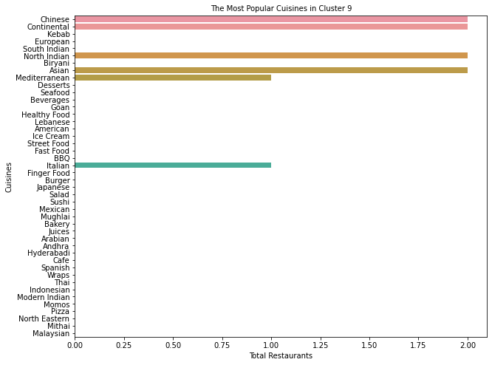
Cluster 9:
Average Rating: 3.87
Average Cost: 2000 INR
Total hotels : 2

Slide 25
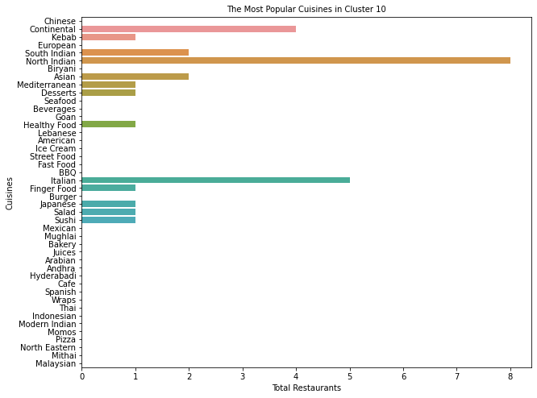
Cluster 10:
Average Rating: 3.83
Average Cost:1275INR
Total hotels: 8

Slide 26
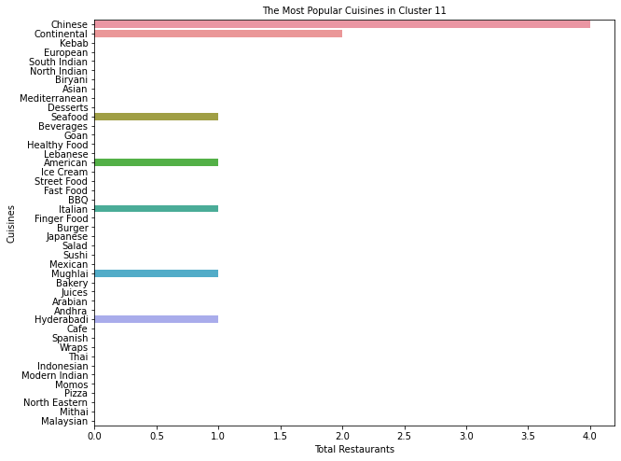
Cluster 11:
Average Rating: 3.62
Average Cost: 887 INR
Total hotels : 4

Slide 27
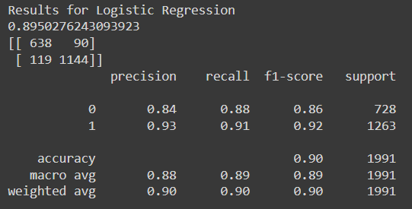
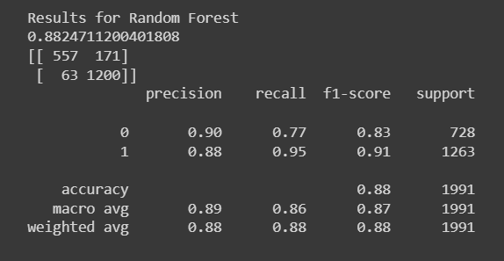
Sentiment Analysis:
In the business problem, predicting the negative sentiments correctly is really important but is more important for the models to reduce the number of false positives.
False positives indicate that the reviews were actually negative but they were categorized as positive and this will lead to missing a complaint to work on.
Even though the number of false negatives is higher in the case of Logistic Regression than in Random Forest, it is performing better in terms of reducing False positives. This indicates that Logistic Regression is penalizing False positives more just as we want.

Slide 28
Conclusion :
Some important conclusions drawn from the analysis are as follows:
The best restaurants in Hyderabad are AB's - Absolute Barbecues, B-Dubs, and 3B's - Buddies, Bar & Barbecue.
The most popular cuisines are the cuisines that most restaurants are willing to provide. The most popular cuisines in Hyderabad are North Indian, Chinese, Continental, and Hyderabadi.
The restaurants in Hyderabadi have a flexible per-person cost of 150 INR to 2800 INR. The cheapest is the food joint called Mohammedia Shawarma and the costliest restaurant is Collage - Hyatt Hyderabad Gachibowli.
Restaurant Clustering was done in two approaches. First with just two features and then with all of them. K means Clustering worked well in the first approach but as we increase the dimensions, it isn't able to distinguish the clusters hence principal component analysis was done and then clustered into 11 clusters. The similarities in the data points within the clusters were pretty great.
Even though the number of false negatives is higher in the case of Logistic Regression than in Random Forest, it is performing better in terms of reducing False positives. This indicates that Logistic Regression is penalizing False positives more just as we want.
Restaurants with negative reviews should be worked with in order to arrive at a win-win situation.
Ratings should be collected on a category basis such as rating for packaging, delivery, taste, quality, quantity, service, etc. This would help in targeting specific fields that are lagging.

Slide 29
THANK YOU

